Slide 1
Job Role Prediction
Ananya Mathur 500091437 R2142210104 Batch -1 AIML(H)

Slide 2
ABOUT THE PROJECT
The project involves building a resume prediction system using natural language processing (NLP) techniques and machine learning. Here's a description of the project:
Objective: The main objective of the project is to predict job profiles based on the skills mentioned in a resume..
Functionalities:
User Interface: The project provides a user-friendly interface using tkinter, allowing users to input skills or keywords.
Preprocessing: The input skills are preprocessed using techniques like tokenization and stopwords removal to clean the text data.
Prediction: The preprocessed skills are then used to predict the job profile using a trained machine learning model. The models used are TF-IDF Vectorization and Support Vector Classifier
Display Results: The predicted job profile and relevant information like the ATS score are displayed to the user.
Training Data: The machine learning model is trained on a dataset containing resumes along with their associated job profiles.
User Interaction: The system provides an interactive experience to users, allowing them to input skills and view predictions. This enhances usability and makes the system more intuitive for users.

Slide 3
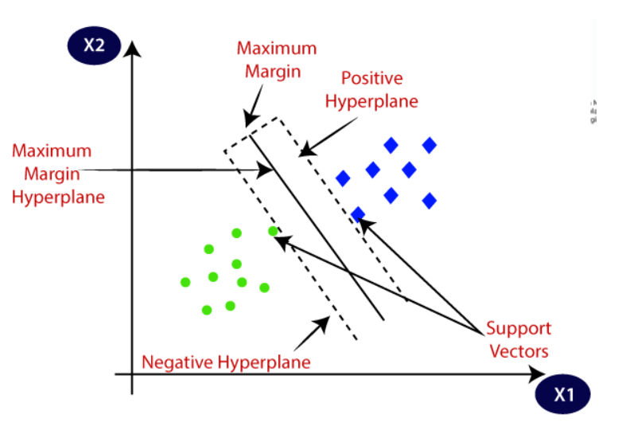
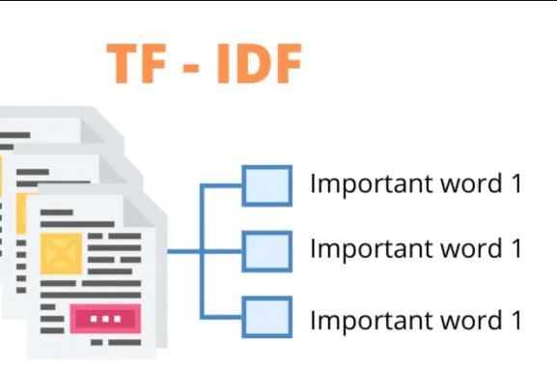
TF-IDF VECTORIZER AND Support Vector Machine
TF-IDF (Term Frequency-Inverse Document Frequency) vectorizer is a technique used in natural language processing for converting text documents into numerical representations. It calculates the importance of a word in a document relative to a collection of documents. TF-IDF assigns higher weights to words that are frequent in a document but rare across all documents, helping to capture the uniqueness of words in a document. This vectorizer is widely used in tasks such as text classification, information retrieval, and clustering.
Support Vector Machine (SVM) is a supervised machine learning algorithm used for classification and regression tasks. It works by finding the optimal hyperplane that best separates different classes in the feature space. SVM aims to maximize the margin between classes, making it robust to noise and effective in high-dimensional spaces. It can handle both linear and non-linear data through the use of kernel functions

Slide 4
THANKYOU

